Slide 1

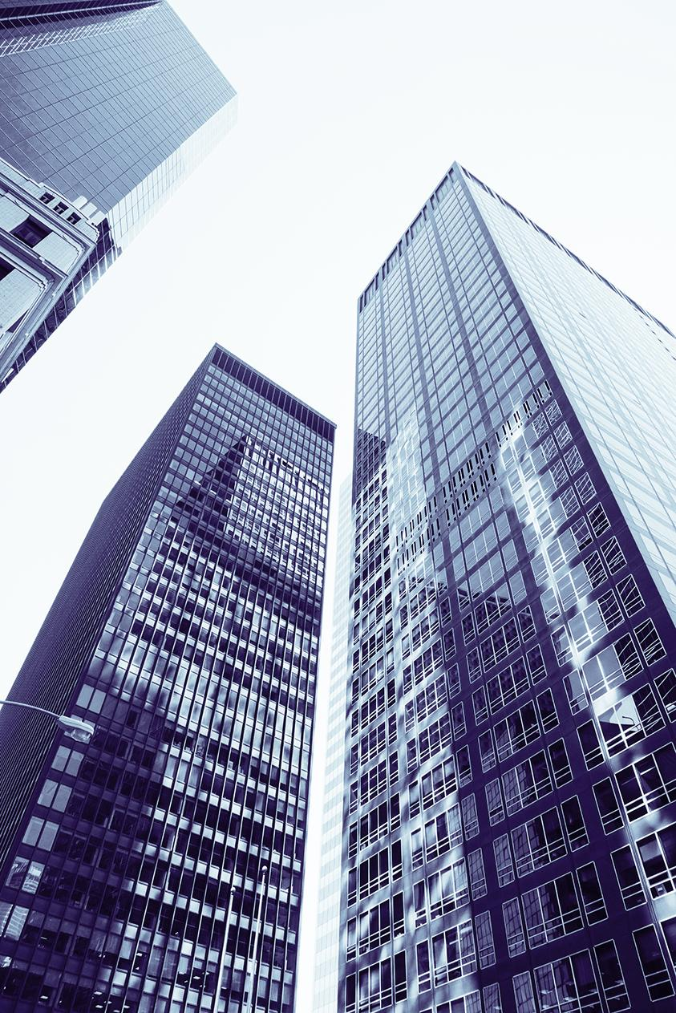

Customer Churn Prediction: Energy Provider Case Study
Vigèr Durand Azimedem Tsafack
Advior:
Anagnostopoulos Aristidis
External Advior:
Ianni Andrea

Slide 2
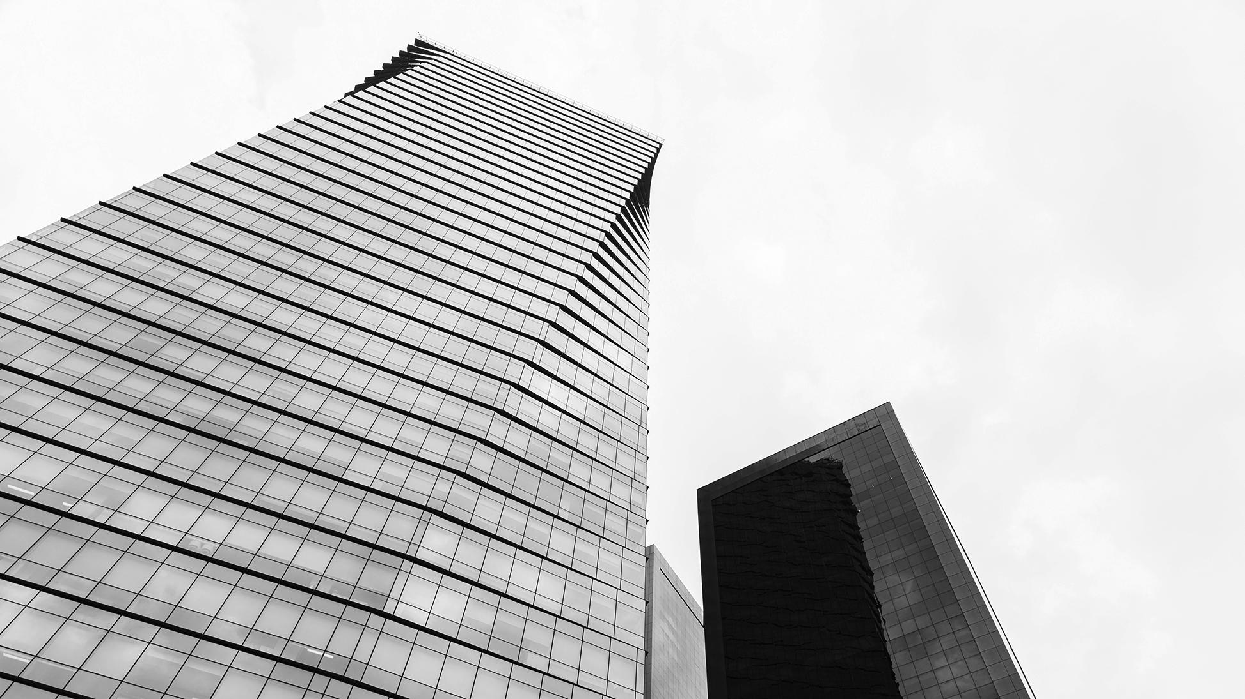
Bill Gates
“Your most unhappy customers are your greatest source of learning.”

Slide 3
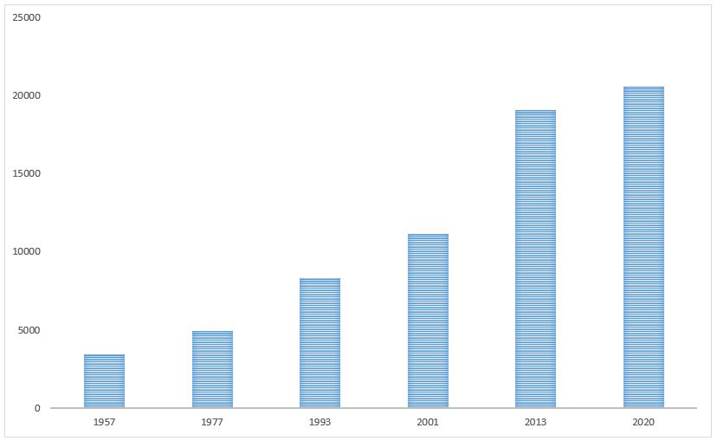

Energy Providers in Italy from 1957 to 2020
Regulatory Authority for Energy, Networks and the Environment.
Favors the development of a competitive energy market.
The number of energy providers in italy increases almost exponentially through the years.
Source:
https://www.arera.it/ModuliDinamiciPortale/reportistica/compilaRicerca

Slide 4
Probems
Prediction
Satisfaction
How to know in advance if a client is about to churn ?
What action to take to increase customer satisfaction ?
Retention
Lost of money
What to do to reverse the churn process ?
Retain clients and pevent the lost of money.

Slide 5
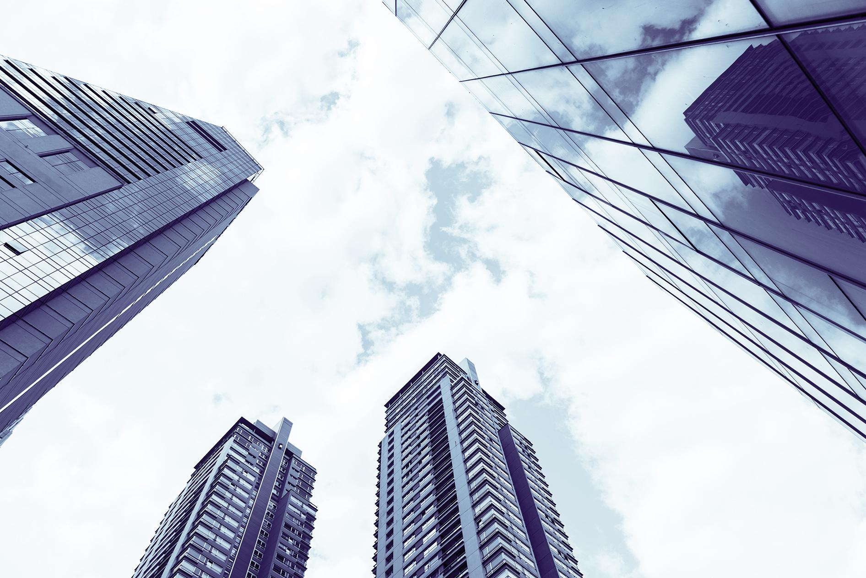
Solution
Usage of Data Science techniques to build models able to predict if a client is about to churn.

Slide 6







The Process
1
3
5
Data Collection: From company’s areas to Data Lake
Results: Gathering all the results
Data
Preprocessing: Format the data for modeling
2
4
6
Feature Creation: Aggregate collected data and create features
Modeling: Building predictive models
Analysis: Further analysis

Slide 7
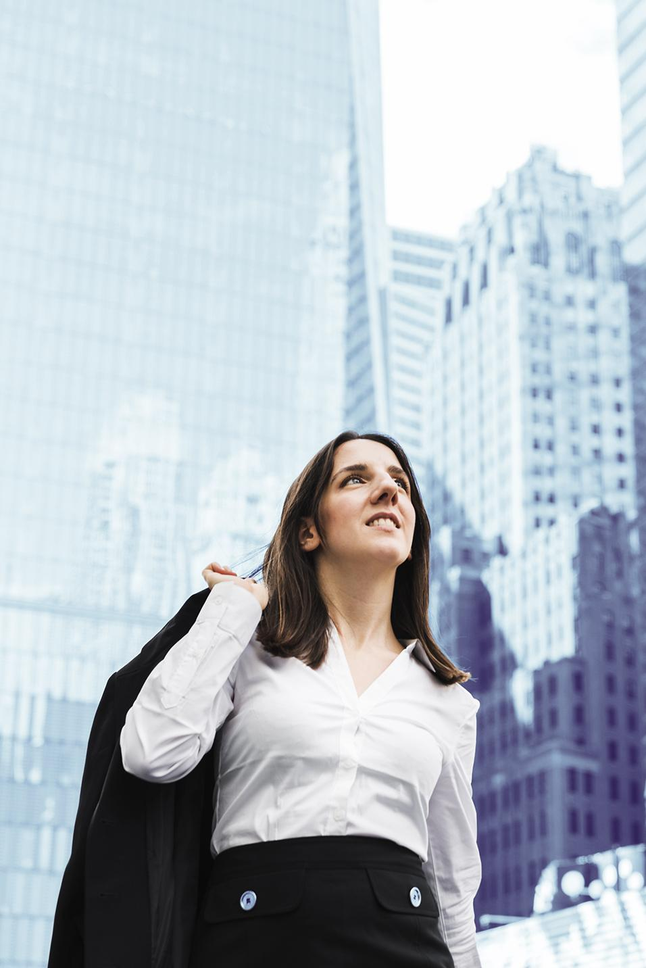
01
Data Collection
From company’s areas to Data Lake

Slide 8

Thanks!
Do you have any questions?
vigerdurand@yahoo.fr

Slide 9
Contents of This Template
Here’s what you’ll find in this Slidesgo template:
A slide structure based on a multi-purpose presentation, which you can easily adapt to your needs. For more info on how to edit the template, please visit Slidesgo School or read our FAQs.
An assortment of illustrations that are suitable for use in the presentation can be found in the alternative resources slide.
A thanks slide, which you must keep so that proper credits for our design are given.
A resources slide, where you’ll find links to all the elements used in the template.
Instructions for use.
Final slides with:
The fonts and colors used in the template.
A selection of illustrations. You can also customize and animate them as you wish with the online editor. Visit Stories by Freepik to find more.
More infographic resources, whose size and color can be edited.
Sets of customizable icons of the following themes: general, business, avatar, creative process, education, help & support, medical, nature, performing arts, SEO & marketing, and teamwork.
You can delete this slide when you’re done editing the presentation.

Slide 10
Table of Contents
01
02
03
First Section
Second Section
Third Section
You could describe the topic of the section here
You could describe the topic of the section here
You could describe the topic of the section here

Slide 11
01
First Section
You can enter a subtitle here if you need it

Slide 12
The Slide Title Goes Here!
Do you know what helps you make your point clear? Lists like this one:
They’re simple
You can organize your ideas clearly
You’ll never forget to buy milk!
The audience won’t miss the point of your presentation

Slide 13
Company and Branding
Mercury is the closest planet to the Sun and the smallest one in the Solar System — it’s only larger than the Moon
YOUR LOGO

Slide 14
Problem
Solution
Mercury is the closest planet to the Sun and the smallest one
Venus has a good name and is the second planet from the Sun

Slide 15
Maybe You Need Two Columns
Mercury
Venus
Mercury is the closest to the Sun and the smallest one in our Solar System
Venus has a beautiful name and is the second planet from the Sun

Slide 16
You Could Use Three Columns
Mars
Jupiter
Saturn
Mars is a cold place. It’s full of iron oxide dust, which gives the planet its reddish cast
It’s a gas giant and the
biggest planet in the Solar System. Jupiter is the fourth-brightest
Yes, this is the ringed one. It’s a gas giant, composed mostly of hydrogen and helium

Slide 17

A Photo Is a Good Idea
Images reveal large amounts of data, so remember: use an image instead of long texts

Slide 18

A Picture Is Worth a Thousands Words

Slide 19
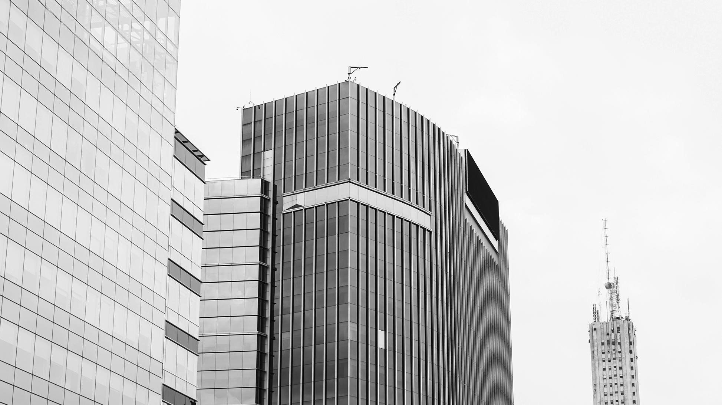
Awesome Words
Because key words are great for catching your audience’s attention

Slide 20

Another Pic with Threads
Mars
Mars is a cold place. It’s full of iron oxide dust, which gives the planet its reddish cast
Jupiter
It’s a gas giant and the biggest planet in the Solar System. Jupiter is the fourth-brightest

Slide 21
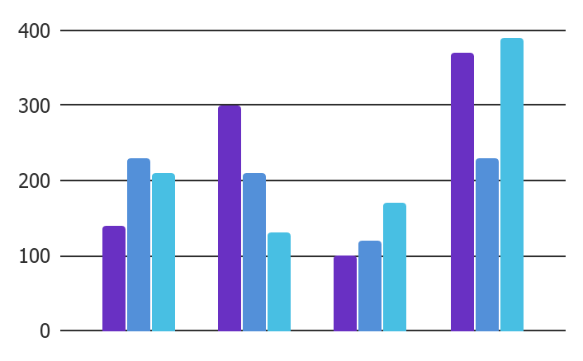
Graphic
Mars
Mars is a very cold place
Jupiter
Jupiter is the biggest planet
Venus
To modify this graph, click on it, follow the link, change the data and paste the resulting graph here, replacing this one
Venus has a beautiful name

Slide 22
Sometimes, Reviewing Concepts Is a Good Idea
Mercury
Venus
Mars
Mercury is the closest planet to the Sun
Venus is the second planet from the Sun
Despite being red, Mars is a cold place
Jupiter
Saturn
Neptune
It’s the biggest planet in the Solar System
Saturn is composed of hydrogen and helium
Neptune is the farthest from the Sun

Slide 23
Infographics Make Your Idea Understandable...
01
02
03
04
Mercury
Venus
Mercury is the small planet
Venus has a good name
Jupiter
Mars
Jupiter is the biggest planet
Mars is a very cold place

Slide 24
… And the Same Goes for Tables
 | Mass | Diameter | Surface Gravity
Mercury | 0.06 | 0.38 | 0.38
Mars | 0.11 | 0.53 | 0.38
Saturn | 95.2 | 9.4 | 1.16

Slide 25
This Is a Map
Mars
Mars is a very cold place
Venus
Venus has a beautiful name

Slide 26
A Timeline Always Works Fine
Mercury is the smallest planet
Jupiter is the biggest planet
Day 1
Day 3
Day 2
Day 4
Mars is a very cold place
Venus has a beautiful name

Slide 27
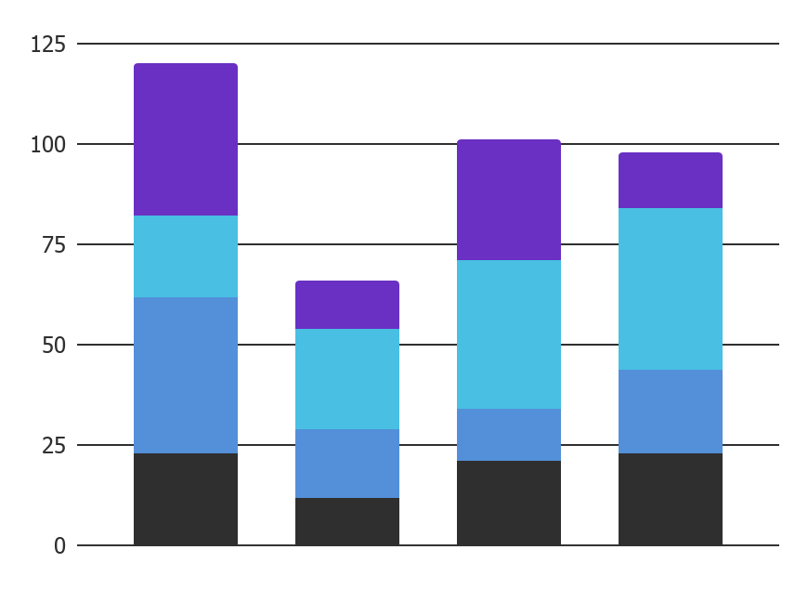
Another Graphic
Mercury
Venus
Mercury is the closest planet from the Sun
Venus is the second planet from the Sun
Jupiter
Mars
It’s the biggest planet in the Solar System
Despite being red, Mars is a very cold place
To modify this graph, click on it, follow the link, change the data and paste the resulting graph here, replacing this one

Slide 28
Company To-do List
You can use this list to describe your work
You can use this list to describe your work
You can use this list to describe your work
You can use this list to describe your work
Mars is a cold place. It’s full of iron oxide dust, which gives the planet its reddish cast

Slide 29
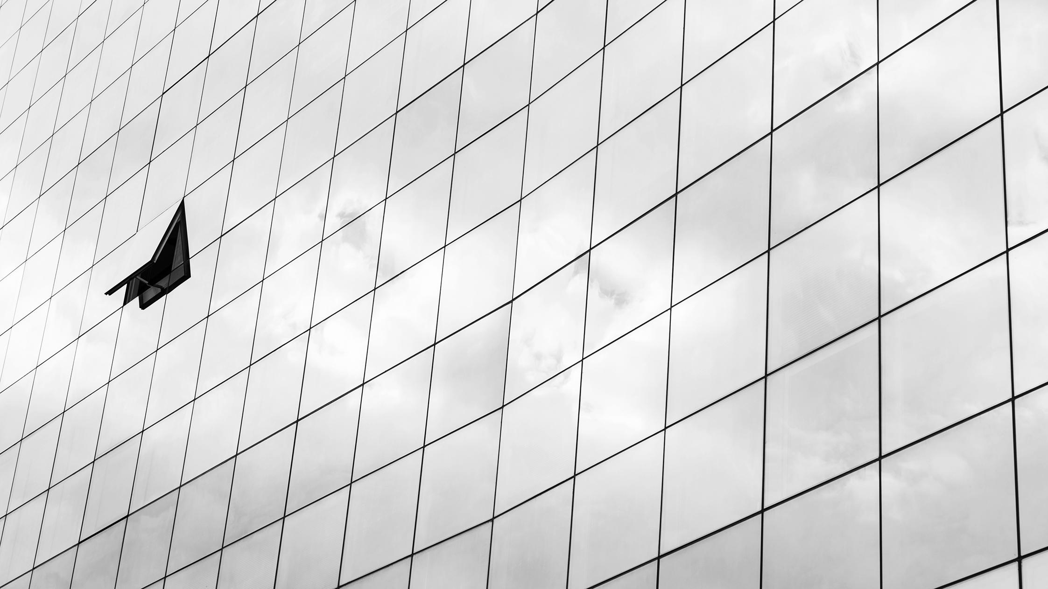
4,800
Big numbers catch your audience’s attention

Slide 30

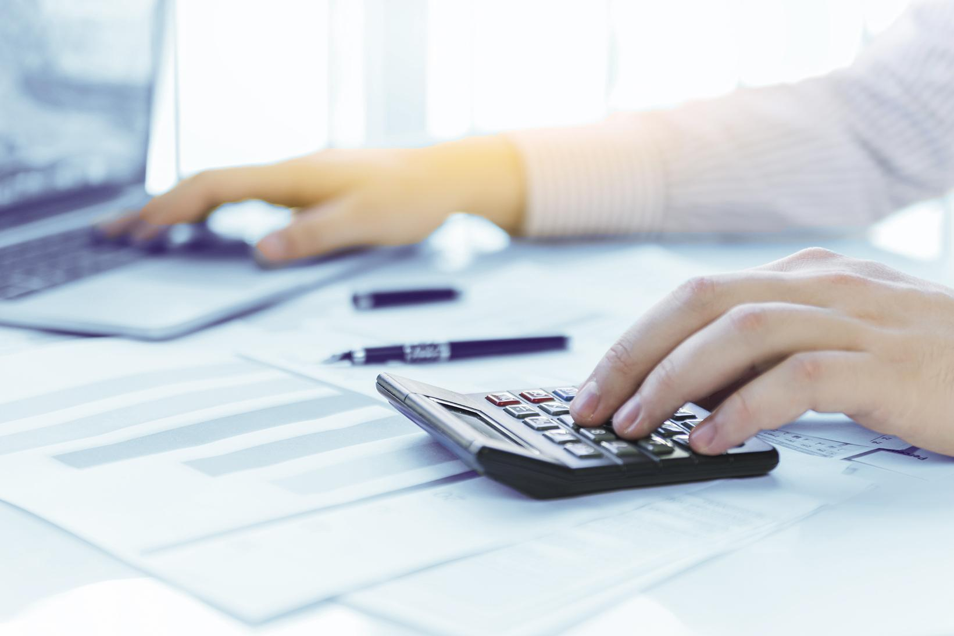

238
500
850
Despite being red, Mars is actually a cold place
Jupiter is a gas giant and the biggest planet
Venus has a beautiful name and is the second planet

Slide 31
Do You Need More Columns?
Mercury
Jupiter
Mercury is the closest planet from the Sun
It’s the biggest planet in the Solar System
Saturn
Neptune
Saturn is composed of hydrogen and helium
It’s the farthest planet from the Sun

Slide 32

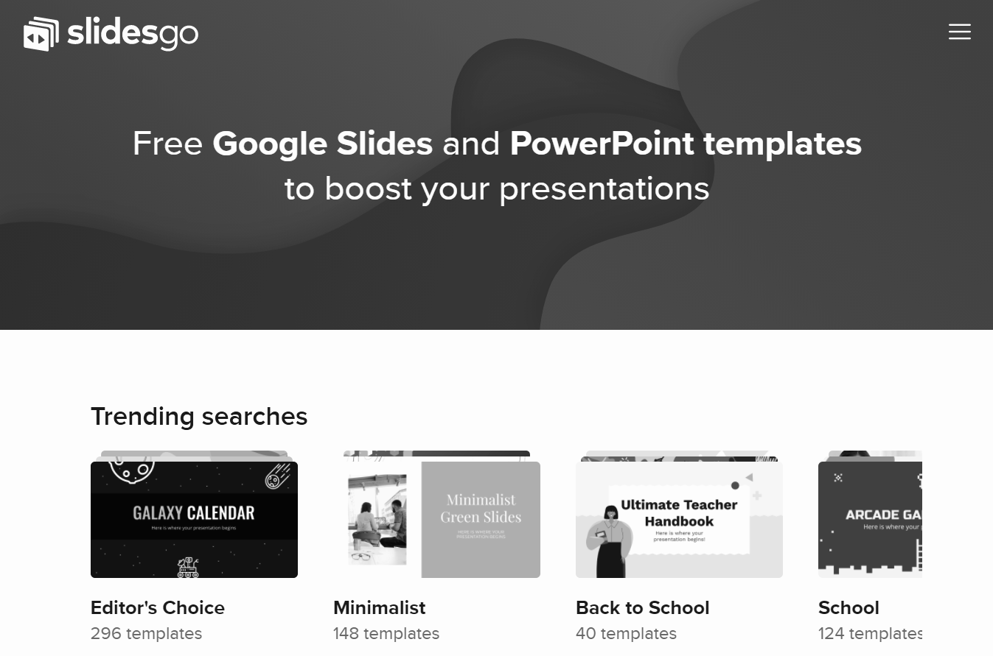
Desktop Software
You can replace the image on the screen with your own work. Just delete this one, add yours and center it properly

Slide 33

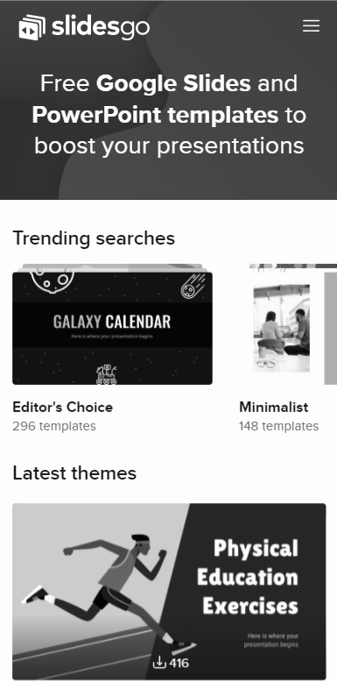
Mobile App and Website
You can replace the image on the screen with your own work. Just delete this one, add yours and center it properly

Slide 34

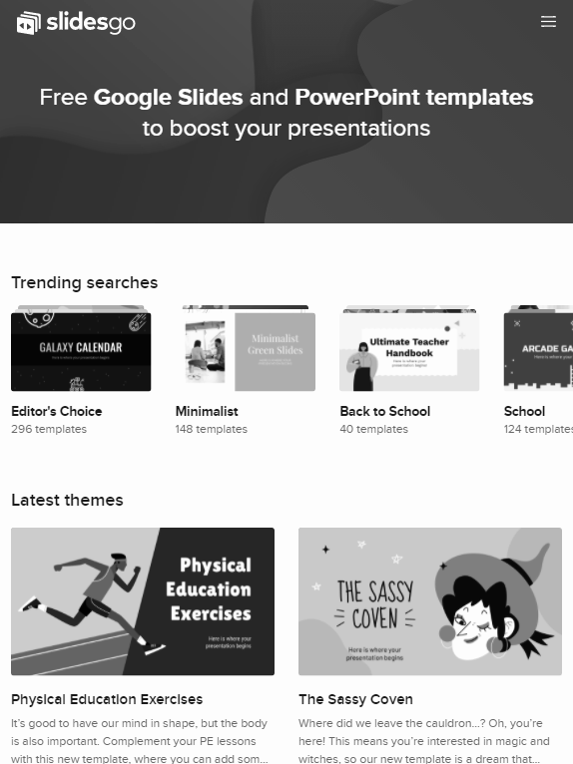
Tablet App and Website
You can replace the image on the screen with your own work. Just delete this one, add yours and center it properly

Slide 35
Work in Progress Board
To Do | In Progress | Testing | Done
You can use this column to show the status of your work or your team | You can use this column to show the status of your work or your team | You can use this column to show the status of your work or your team | You can use this column to show the status of your work or your team

Slide 36

Our Team
Helena Doe
You can replace the image on the screen with your own one
James Price
You can replace the image on the screen with your own one
Jenna Long
You can replace the image on the screen with your own one

Slide 37
Thanks!
Do you have any questions?
youremail@freepik.com
+91 620 421 838
yourcompany.com
Please keep this slide for attribution

Slide 38
Alternative Resources
Brunette business woman outdoors
Businessman using laptop
Man woman walking together dealership
Side view woman working during pandemic with smartphone notepad
Front view working during covid concept
Front view colleagues working during covid
Afro american woman smiling close-up
Fashionable business woman holding takeaway coffee cup digital tablet
Businesspeople
Stylish business man back shot
Businessman with tablet
Businessman
Businessman businesswoman shaking hands front corporate building
Low angle modern glass skyscrapers
Contemporary glass building bottom view
Skyscraper with clouds reflection
Modern buildings skyline view

Slide 39
Resources
Did you like the resources on this template? Get them for free at our other websites
Photos
Skyscrapers with glass facade
Low angle view skyscrapers
Low angle view tall buildings
Low angle smiley woman looking away
Portrait woman office with tablet
Businesswoman holding folder standing front building
Buildings with white sky cloudscape
Executive with arms crossed
Close-up building with opened window
Man hands calculating workplace
Colleagues analysing business chart
Hand putting sticky notes window
Close-up man holding laptop
Close-up hand showing display smartphone road
Front view large tablet mockup
Group three modern architects
Teamwork concept with people
Illustration
Set abstract modern logos

Slide 40
Instructions for use
In order to use this template, you must credit Slidesgo by keeping the Thanks slide.
You are allowed to:
- Modify this template.
- Use it for both personal and commercial projects.
You are not allowed to:
- Sublicense, sell or rent any of Slidesgo Content (or a modified version of Slidesgo Content).
- Distribute Slidesgo Content unless it has been expressly authorized by Slidesgo.
- Include Slidesgo Content in an online or offline database or file.
- Offer Slidesgo templates (or modified versions of Slidesgo templates) for download.
- Acquire the copyright of Slidesgo Content.
For more information about editing slides, please read our FAQs or visit Slidesgo School:
https://slidesgo.com/faqs and https://slidesgo.com/slidesgo-school

Slide 41
Fonts & colors used
This presentation has been made using the following fonts:
Montserrat
(https://fonts.google.com/specimen/Montserrat)
#2f2f2f
#ffffff
#6930c3
#5390d9
#48bfe3

Slide 42





Stories by Freepik
Create your Story with our illustrated concepts. Choose the style you like the most, edit its colors, pick the background and layers you want to show and bring them to life with the animator panel! It will boost your presentation. Check out How it Works.
Pana
Amico
Bro
Rafiki
Cuate

Slide 43
Use our editable graphic resources...
You can easily resize these resources without losing quality. To change the color, just ungroup the resource and click on the object you want to change. Then, click on the paint bucket and select the color you want. Group the resource again when you’re done. You can also look for more infographics on Slidesgo.

Slide 46
JANUARY
FEBRUARY
MARCH
APRIL
MAY
JUNE
PHASE 1
Task 1
Task 2
PHASE 2
Task 1
Task 2
JANUARY
FEBRUARY
MARCH
APRIL
PHASE 1
Task 1
Task 2

Slide 49
...and our sets of editable icons
You can resize these icons without losing quality.
You can change the stroke and fill color; just select the icon and click on the paint bucket/pen.
In Google Slides, you can also use Flaticon’s extension, allowing you to customize and add even more icons.

Slide 50
Educational Icons
Medical Icons

Slide 51
Business Icons
Teamwork Icons

Slide 52
Help & Support Icons
Avatar Icons

Slide 53
Creative process Icons
Performing Arts Icons

Slide 54
Nature Icons

Slide 55
SEO & Marketing Icons

Slide 56


